Slide 1
Date: 19/07/2021
Presentation
Fraud Detection in E-commerce Using Machine Learning
Harshit Agarwal, Nikhil Kumawat
Supervisor : Prof. Shree Prasad M

Slide 2

Topic
FRAUD DETECTION IN E-COMMERCE USING MACHINE LEARNING

Slide 3
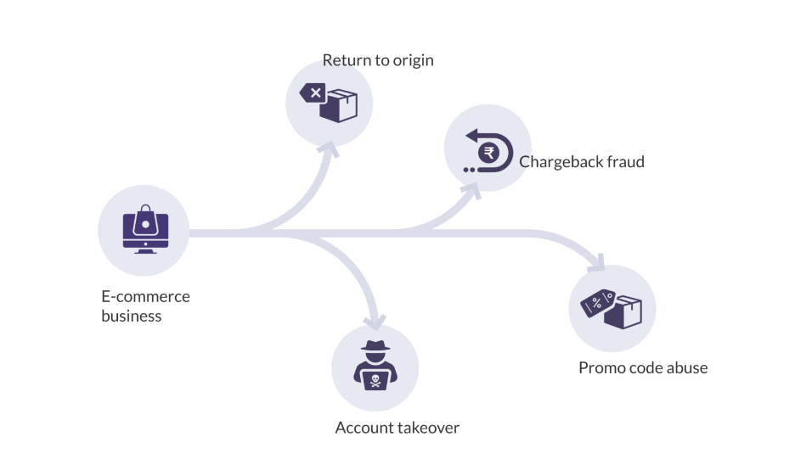
Introduction

Slide 4
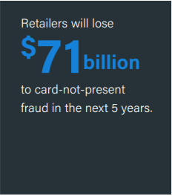
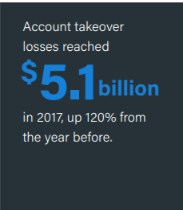
Fraud: A costly growing problem

Slide 5
Fraud Detection in E-commerce
Few questions that need to be answered in order to detect e-commerce fraud
Do clients access services in an expected way?
Are user actions normal?
Are transactions typical?
Are there any inconsistencies in the information provided by users?

Slide 6
Machine Learning
Machine Learning is the science of getting computers to learn and act like humans do, and improve their learning over time in autonomous fashion, by feeding them data and information in the form of observations and real world interactions.
Examples:
Siri, Alexa, Google Assistant
Recommendation on Netflix, Amazon

Slide 7
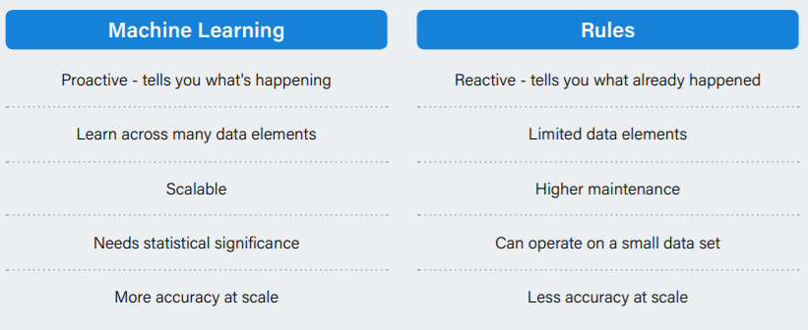
Why to use Machine Learning for Fraud Detection?
In Short, humans cannot comprehend how each factor in the e-commerce ecosystem might be affecting the fraudulence of a particular order

Slide 8

Benefits of Machine Learning for E-commerce Fraud Detection
Ability to detect fraud without impeding the user experience
Highly Accurate Results
Reduce the need for manual review
Frees up teams’ time to focus on more strategic work
Can be automated
Adapts quickly

Slide 9
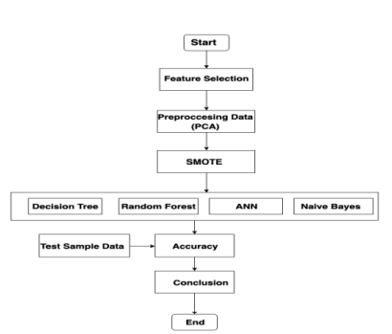
Plan of work
Loading Dataset into a Dataframe
Cleaning and exploring the dataset
Feature selection and Feature engineering
Dealing with imbalanced class data
Modelling
Analyzing the model performance from Confusion matrix
Testing

Slide 10
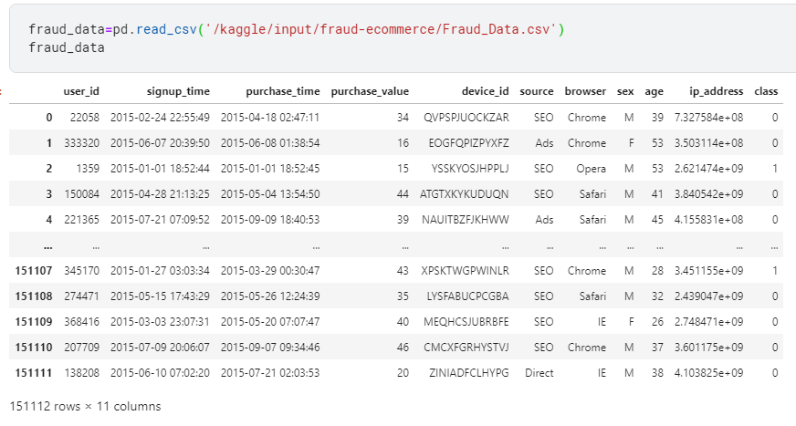
Dataset Loading

Slide 11
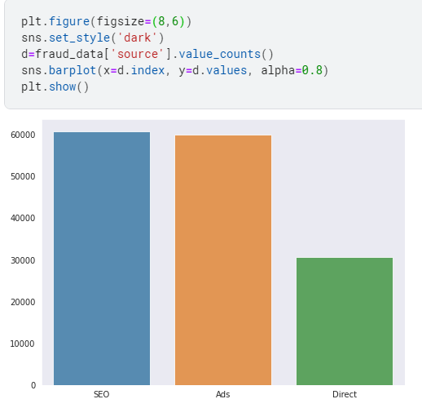
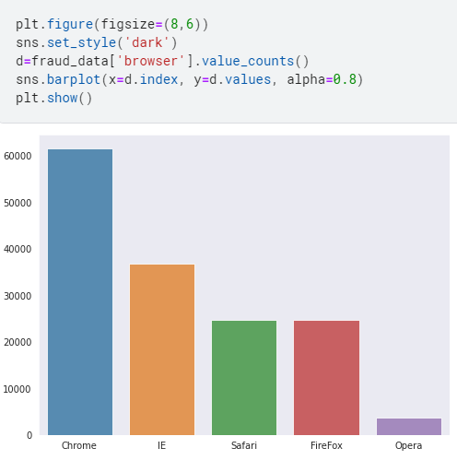
Exploring Dataset

Slide 12
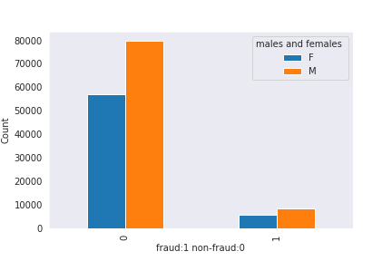
Contd.
plt.figure(figsize=(10,6))
sns.set_style('dark')
d=fraud_data['sex'].groupby(fraud_data['class']).value_counts().unstack()
d.plot.bar()
plt.legend(title='males and females ', loc='upper right')
plt.xlabel('fraud:1 non-fraud:0' )
plt.ylabel('Count')
plt.show()

Slide 13

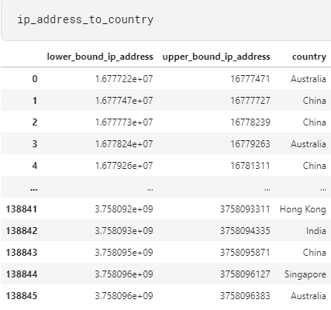
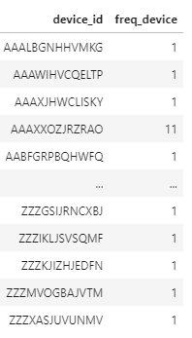
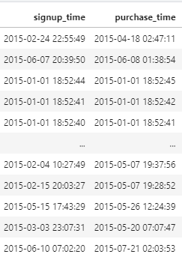
Feature Selection and Feature Engineering
Three new and intuitive features were created from the existing features.
freq_device from device id.
buy_t (in hours) from signup_time and purchase_time
country from ip_address

Slide 14
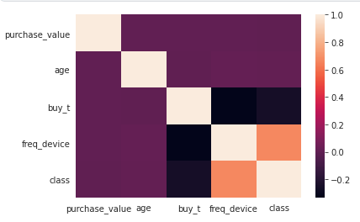
Correlation matrix between each feature and target variable
Negative correlation was found with buy_t and chances of being fraud

Slide 15
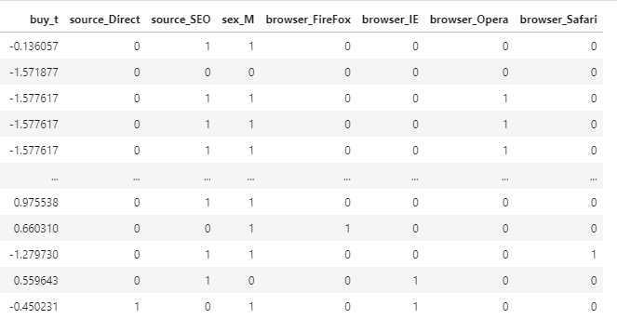
Encoding the categorical variables
Features like source and browser were one hot encoded.

Slide 16
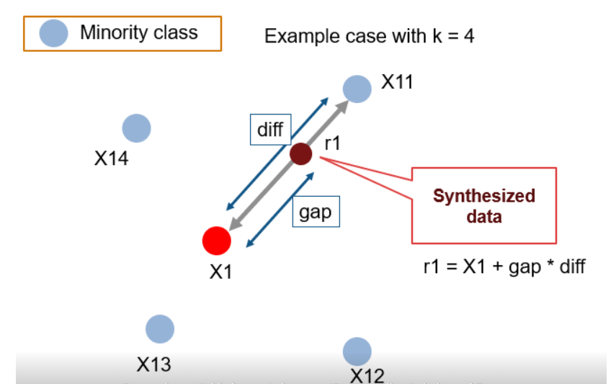
Using SMOTE to deal with imbalanced Dataset.
Less than 10% of dataset contains the class label as 1 (fraud).
ML model trains well on balanced dataset.

Slide 17
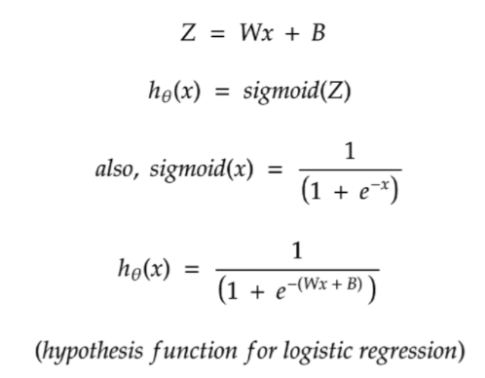
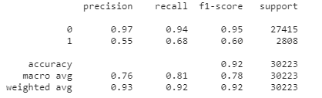
Modelling
First model which we employed is Logistic regression model.
In logistic regression hyperparameters could be the number of iteration to achieve convergence and the threshold above which we defiance the class label as 1.
We tune hyperparameter by experimenting with different values and checking up with the model performance.
Model performance can be measured by confusion matrix.

Slide 18
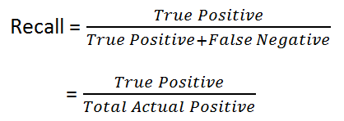
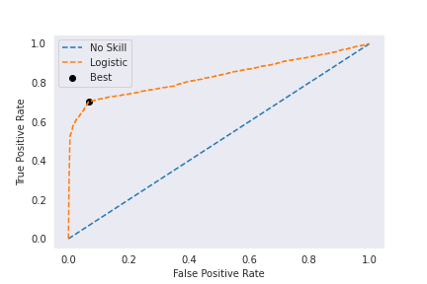
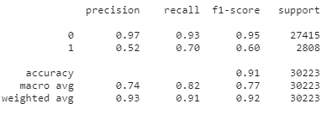
Importance of Recall in Fraud Detection
For fraud detection recall is the optimum metric as we want to reduce the cases where we mark fraud as non fraud.
We can maximise recall by changing the threshold.
ROC curves are useful in doing that.
Optimum threshold was found to as 0.319412
Using the above threshold instead of 0.5 we got better results.

Slide 19
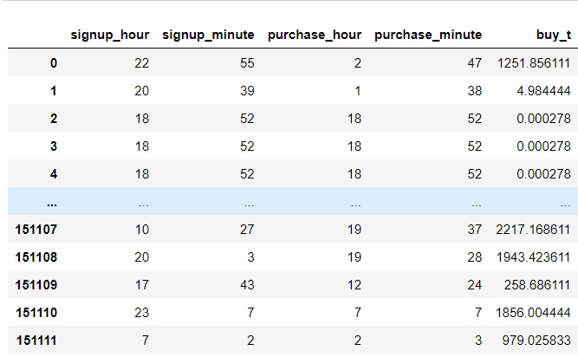
Experimenting for Best ML model
Creating new date-time features
On noticing a high correlation between buy time and classification, it was induced to use date-time features like at what hour of the day the account was signed up and the purchase was made. So hour and minute was introduced as new features in our dataset.

Slide 20
Creating variations of dataset:
3 new variation of dataset we created namely:
SMOTE
Borderline SMOTE
PCA
The above variations of the dataset were used in combinations with different models to achieve better results.

Slide 21
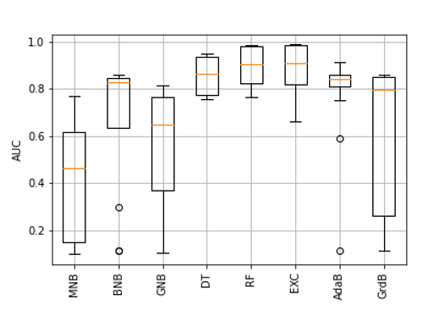
Finding the best combination of dataset and model:
So in total 4 variations of dataset were tested against different models, to judge different models in classification related tasks it is always advised to go by AUC of ROC instead of accuracy .

Slide 22
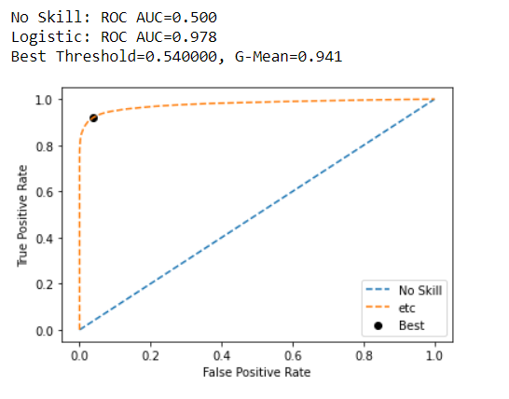
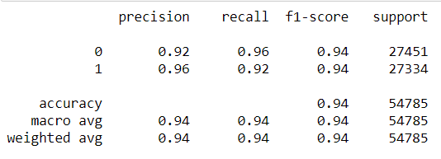
Optimizing the threshold for Extra trees Classifier
After finalising the model, further optimisation of AUC was performed by changing the threshold.
After updating the threshold value, better results were found in the classification report -

Slide 23
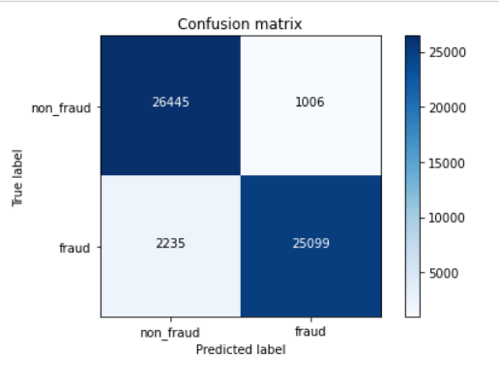
Confusion matrix for extra trees Classifier model

Slide 24
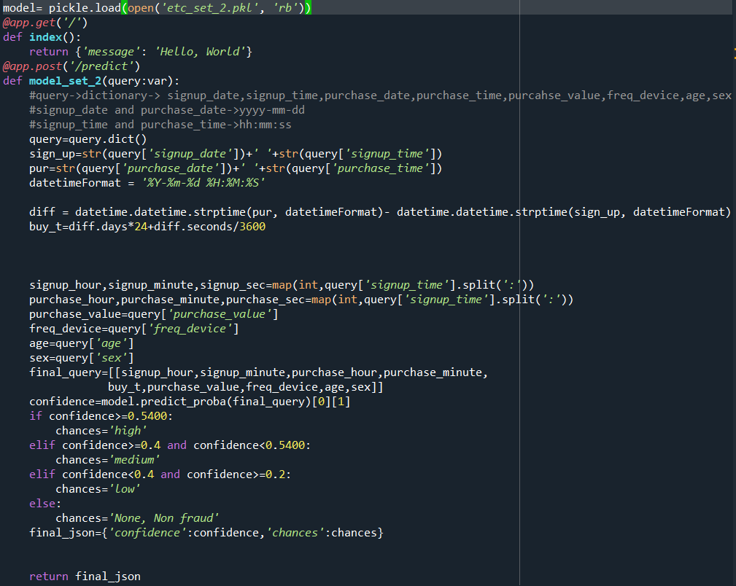
Model Deployment
To create Rest APIs for our model , FastAPI was used. Before using FastAPI a python script was written to load the pickled model and accept a json and return the json file with confidence level and score for fraudulence in a particular order.

Slide 25
Challenges and beyond
Huge dataset with class imbalance increases the computational power requirement for advance decision based models.
By increasing recall we also increase the false positive rate and in turn we flag many non frauds as frauds.
Features used in training dataset and live data may vary.
4. Better Model pickling algorithms which can further compress the model size.
5. Integrating the REST API with the main website to perform in real time.
6. Developing a better dataset with more attributes which can better describe our target variable.

Slide 26
Conclusion
In conclusion, it was found that classical ML models, especially tree based models outperformed deep learning methods. Deep learning methods are prone to overfitting and sharp minima thus fails to perform well on test dataset. Since Decision tree based methods worked well, so to reduce variance ensemble learning methods like Random forests and extra trees classifier performed great on test dataset too. Also, instead of creating the webapp to create api as in django or flask, FastAPI is a much better framework to just create REST API.

Slide 27
Thank You

